Slide 1
Comparison of the most liveable cities in the world

Slide 2
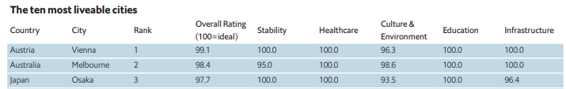
Introduction
Vienna, Melbourne, Osaka are the most livable cities in the world. They are located in different countries, are multicultural, and the only capital of their respective country is Vienna.
We want to explore how similar they are, to find out if there is any pattern in the city's view of restaurants, parks and places that make these cities the most livable in the world, or even discover the different aspects between them .
Comparing the four cities will help people who are looking for the best places to live or who would like to know them to choose the specific places, and the curious ones who would like to know the main places that exist in those cities and if that tends to be similarity between them.

Slide 3
Data Description
To consider the problem we can list the datas as below:
The Global Liveability Index of 2018: [Link]
Vienna Neighborhoods: [Link]
Melbourne Neighborhoods: [Link]
Osaka Neighborhoods: [Link]
I used Foursquare API to get the most common venues of given Neighborhoods of cities [Link]

Slide 4
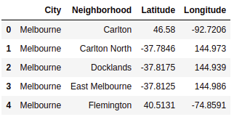
Methodology
As a database, I used GitHub repository in my study. My master data which has the main components Neighborhood, Latitude and Longitude informations of the cities.

Slide 5
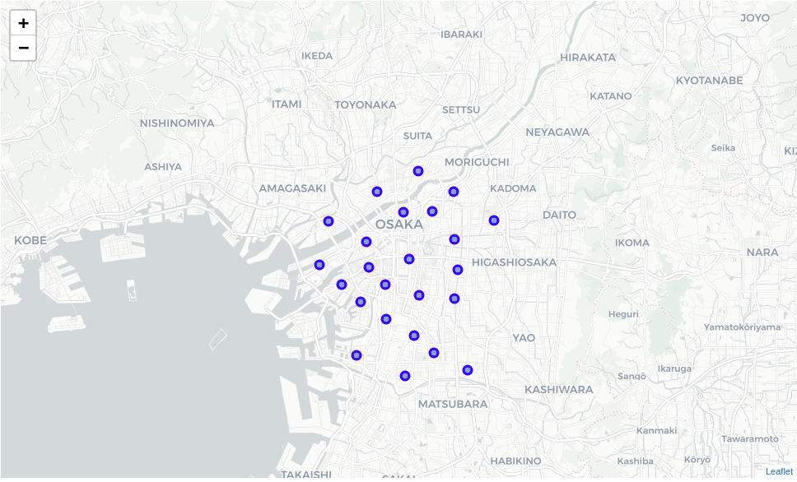
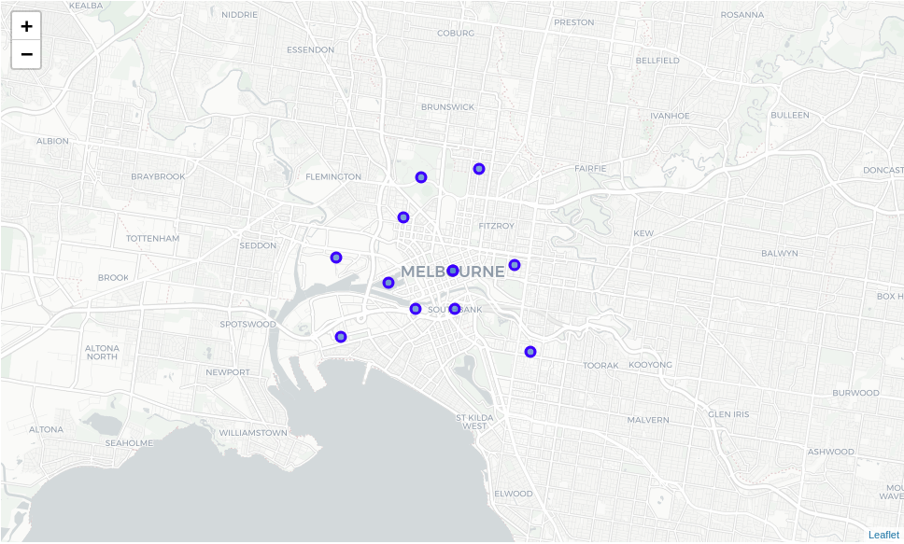
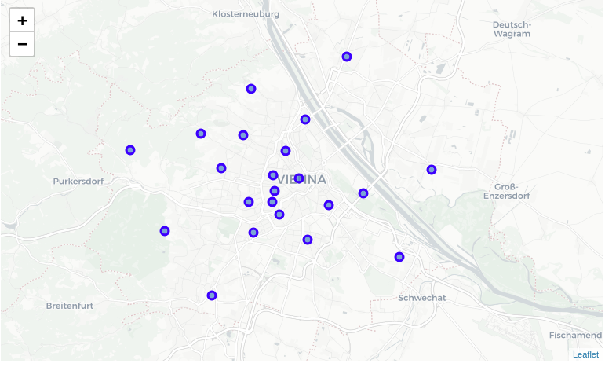
I used python folium library to visualize geographic details of Vienna, Melbourne and Osaka, and its boroughs and I created a map of cities with Neighborhoods superimposed on top. I used latitude and longitude values to get the visual as below:

Slide 6
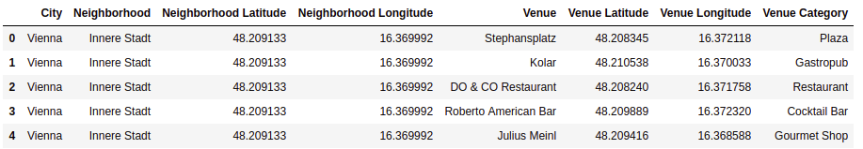
I utilized the Foursquare API to explore the Neighborhoods and segment them. I designed the limit as 100 venue and the radius 500 meter for each Neighborhood from their given latitude and longitude informations. Here is a head of the list Venues name, category, latitude and longitude informations from Forsquare API.

Slide 7
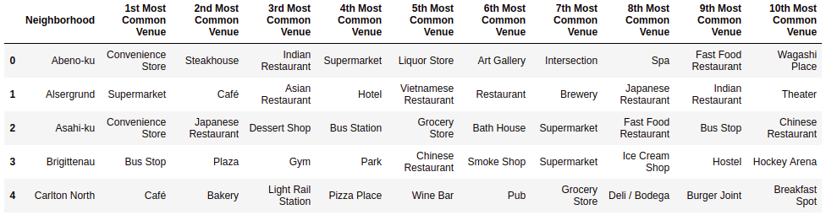
In summary of this data 1777 venues were returned by Foursquare. Here is a merged table of boroughs and venues.
In this graph 251 unique categories were returned by Foursquare, then I created a table which shows list of top 10 venue category for each neighborhood in below table.

Slide 8
We have some common venue categories in neighborhoods. In this reason I used unsupervised learning K-means algorithm to cluster the neighborhoods. K-Means algorithm is one of the most common cluster method of unsupervised learning.

Slide 9
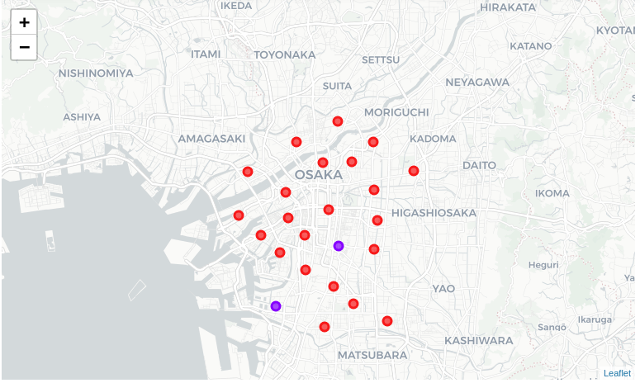
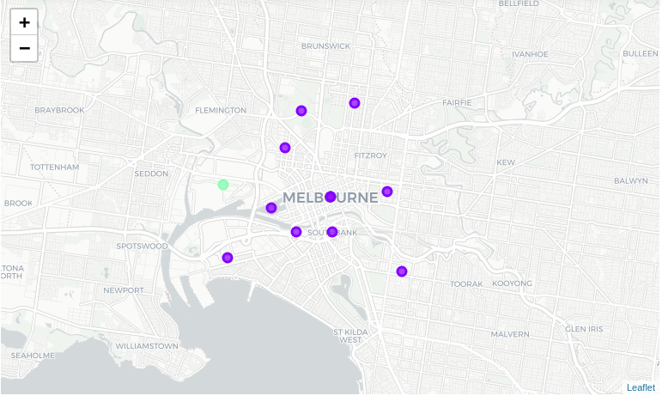
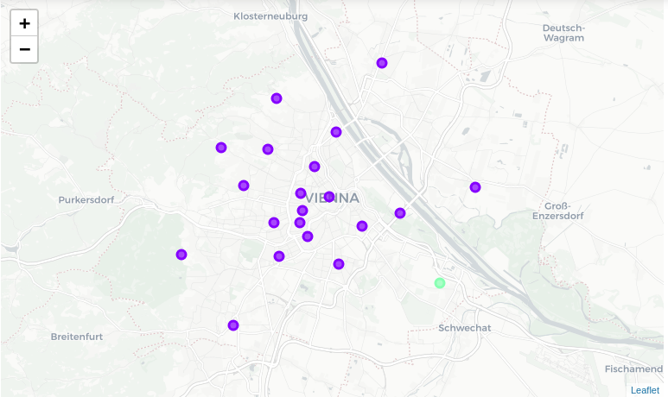
Results
The result of the grouping was this:

Slide 10
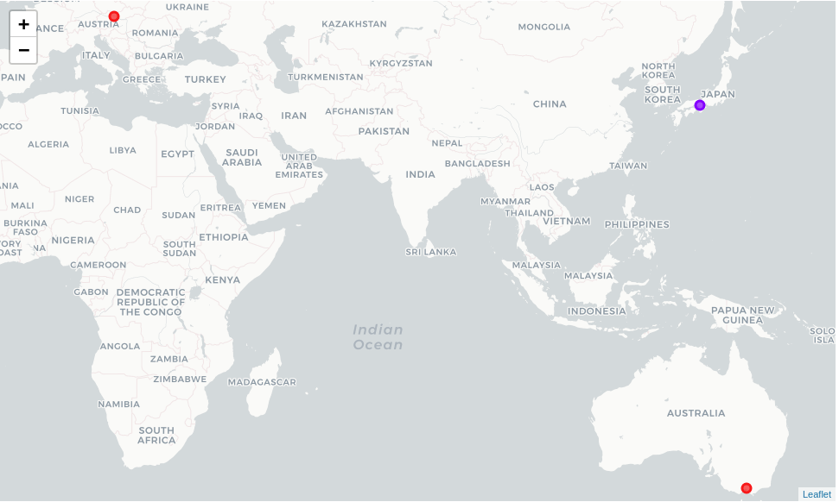
In the final section I did the same for the cities.

Slide 11
I made a word cloud to see the main locations of each cluster

Slide 12
When we examine above graph we can label each cluster as follows
Cluster 0
Cluster 1
Cluster 2
In cluster 0 are the majority of the districts of the city of Osaka, that stand out by its large number of convenience stores and restaurants
In cluster 1 are the majority of the districts of the city of Vienna and Melbourne, and two districts of Osaka, where the highlight are multiple social venues
In cluster 2 were a neighborhood of vienna and a district of Melbourne where the highlight here is Asian restaurants and Zoo Exhibit

Slide 13
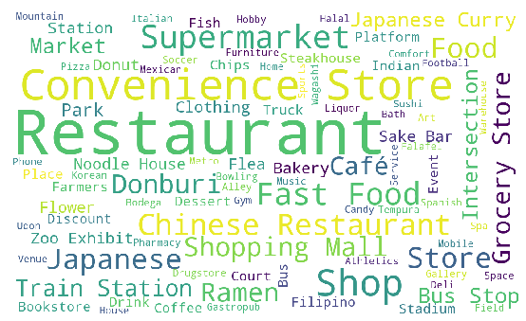
Cluster 0 WC

Slide 14
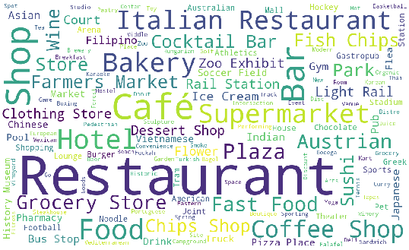
Cluster 1 WC

Slide 15
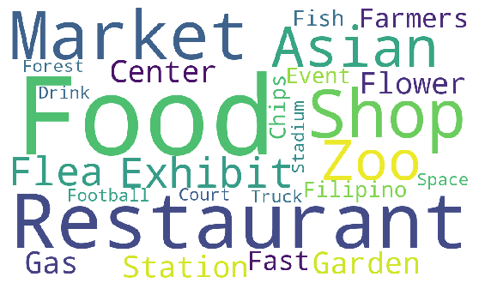
Cluster 2 WC

Slide 16
Discussion
When we compared the neighborhoods, we saw that there are neighborhoods that flee from the pattern of their respective cities, which is very interesting and that Osaka has a great similarity between its neighborhoods.
When comparing the cities, there are a large number of restaurants among them, but individually, Vienna and Melbourne stand out by number of Café and Osaka by the number of Convenience Store.
We could also observe that the two top cities in the ranking of livable cities, Vienna and Melbourne are quite similar.

Slide 17
Conclusion
Well, with this research, we can conclude that Vienna and Melbourne are quite similar in terms of their neighborhoods, with several of their main places in common such as Café, Hotels and Italian Restaurants that are in the top five places of the two cities, we note that despite the dissimilarity of Osaka with these two cities, it is still at the top inhabited cities of the world, finally, we can also notice that despite multicultural cities, there are similar neighborhoods between the three, which is of great help for those who want to visit these places and is already accustomed to some of them.

